Slide 1

News Downloads and Aboutness
Corpus Linguistics, University of Birmingham
July 2017
Mike Scott
Aston University
Lexical Analysis Software

Slide 2





The Issue
Checking & filtering aboutness in news texts from agencies like these

Slide 3
Theme 1: Aboutness and Fields

Slide 4
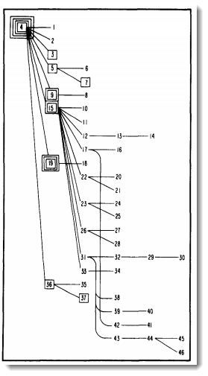
Text and Aboutness
professional interest in main points since 1970s
gist
repeated words
Kintsch & Van Dijk (1978)
coherence graph (1978:379)
of linked propositions

Slide 5
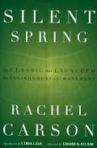
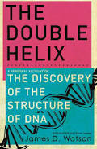

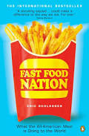
Text and Aboutness
most texts relate to a clear field of knowledge
ecology
genetics
biography & race
business

Slide 6


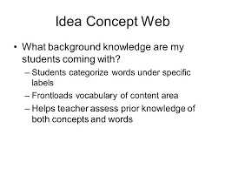
Text Selection in language teaching

Slide 7
Field of knowledge
motorbikes
physics
sociology
geography
DIY
philosophy
law
medicine
John Holmes
Brazilian National ESP Project, 1980s
mathematics
music
history
Pink Floyd

Slide 8
Field of knowledge
personal interests
other academic fields
choose texts which bridge the specialism and another field
subject
specialism
Engineering + Art
elegant buildings, award-winning skyscrapers
gender and the dental profession
early heart operations
Dentistry + Sociology
Medicine + History

Slide 9

fields within specialism…
jogging
history
geography
literature
linguistics
biology
mountain climbing
historical
lexis
grammar
applied
phonetics
pyscho-
corpus
socio-
forensic
etc.

Slide 10
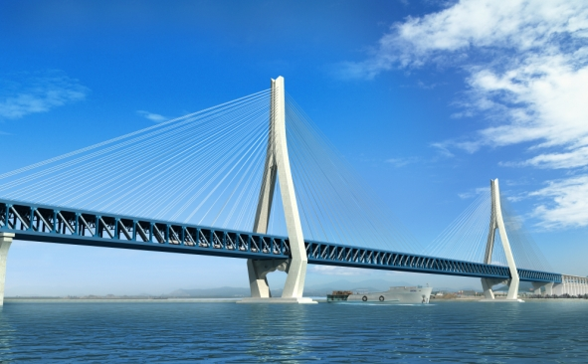
Conclusion 1: text aboutness and fields
sub-fields within fields
fields relate to each other
find bridges between fields

Slide 11

Theme 2: research methods
the good
the ideal
the inefficient

Slide 12
Research process
interest in a topic
starting idea, hypothesis
publish
collect data
write it up
process the data
interpret what it shows
overview of what was found

Slide 13
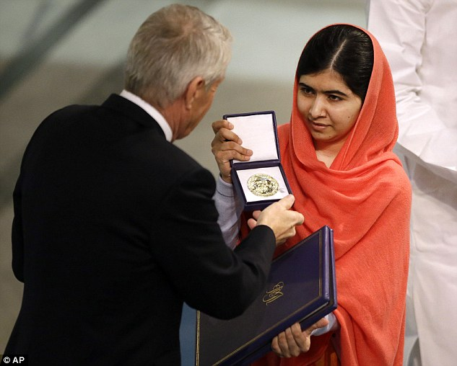


Slide 14
Real-world research
interest in a topic
starting idea, hypothesis
publish
collect data
write it up
process the data
interpret what it shows
overview of what was found

Slide 15

numerous returns to earlier stages
errors
data cleaning
add or remove data
chase up leads

Slide 16


a thinking process

Slide 17
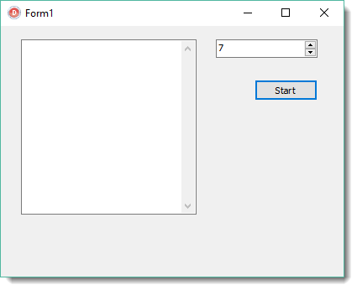
very simple program
one button
one number input window
one memo for writing

Slide 18
function TForm1.AddNeighbourNumber(n : integer): integer;
begin
Memo1.Lines.Add(Format(‘adding %d',[n]));
if n=0 then
Result := 0
else
Result := n + AddNeighbourNumber(n-1);
end;
procedure TForm1.Button1Click(Sender: TObject);
var n : integer;
begin
Memo1.Clear;
n := AdvSpinEdit1.Value;
Label1.Caption := Format('Total of the numbers 1 to %d is %d',[n,AddNeighbourNumber(n)]);
end;

Slide 19
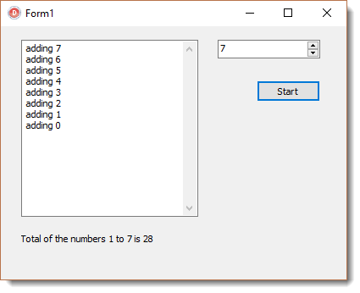

Slide 20
function AddNeighbourNumber(n : integer): integer;
begin
Memo1.Lines.Add(Format(‘adding %d',[n]));
if n=0 then
Result := 0
else
Result := n + AddNeighbourNumber(n-1);
end;

Slide 21

fractals involve recursion

Slide 22
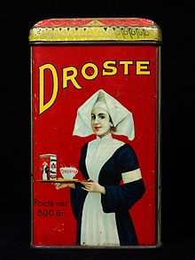



Slide 23
... there’s a much quicker way
Add numbers from 1 to 1 thousand?
Notice that
adding top number to bottom number
is the same for each pair
do 1000 additions? 1 +2 + 3+ 4 + 5 + 6 ….
1 + 1000 = 1001
2 + 999 = 1001
3 + 998 = 1001

Slide 24
less iterative, three-step solution
find the number of pairs
add top number to bottom number
multiply by number of pairs
1 to 1 thousand is 500 pairs
1 + 1000 = 1001
500 * 1001 = 500,500

Slide 25
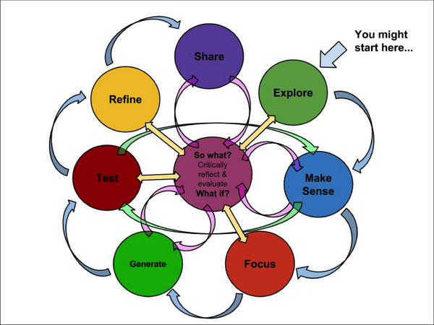
Conclusion 2: inefficiency
in the real world, one never carries out through the research process in one go
unlikely to find a highly efficient method
because the issues are more complex than maths algorithms
there will be recursion but not like in the maths program

Slide 26

Theme 3: News Download study

Slide 27
Objectives
identify a suitable corpus of climate change articles
from UK broadsheet press
problem: what counts as a climate change article?

Slide 28
Bednarek & Caple (2017)
Factiva texts on cycling
cycling OR cycled OR bicycl* OR biking* OR … (24 search-terms altogether)
skim read each text to “exclude items unrelated to cycling or where bikes or cycling are only mentioned in passing […] opinion pieces, editorials, letters to the editor” (2017:140)

Slide 29
Dayrell (2015)
Factiva, texts on Urban Violence
14 search-terms: Violência Urbana, Segurança pública etc.
a further 7 to be excluded
“any reference to urban violence is considered relevant, even if urban violence is not the main topic discussed in the text” (2015: 4)

Slide 30

if using many many thousands of texts….
key words procedures
data mining (Murakami, Thompson, Hunston & Vajn forthcoming in Corpora 2017)

Slide 31
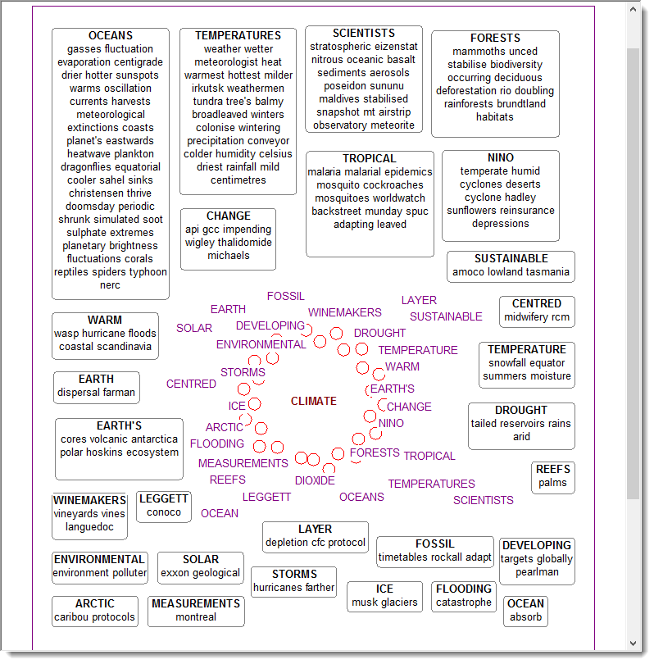
Scott 2002
Key words database, using 800,000 Guardian texts

Slide 32

Even so,
Hard to ensure the texts in a download corpus are suitable

Slide 33





LexisNexis search
downloaded and cleaned up, removing duplicates
Download Parser (Scott, 2017)
search terms: global warming, climate change, greenhouse effect
GUARDIAN: (48,633 articles)
TIMES & SUNDAY TIMES: (23,004)
DAILY & SUNDAY TELEGRAPH: (25,149)
INDEPENDENT & INDEPENDENT ON SUNDAY: (18,617)
OBSERVER: (4,699)
120,102 articles. 128m words.

Slide 34
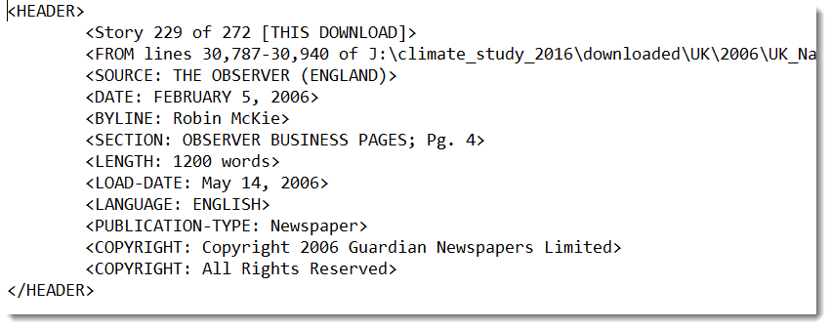
Format

Slide 35

Headlines traced and marked up

Slide 36
duplicate texts problem
algorithm:
where headlines are identical,
are texts A and B the same?
or
(is the length of text A within 2% of length of B?
and are the repeated words of closely similar frequency)?

Slide 37
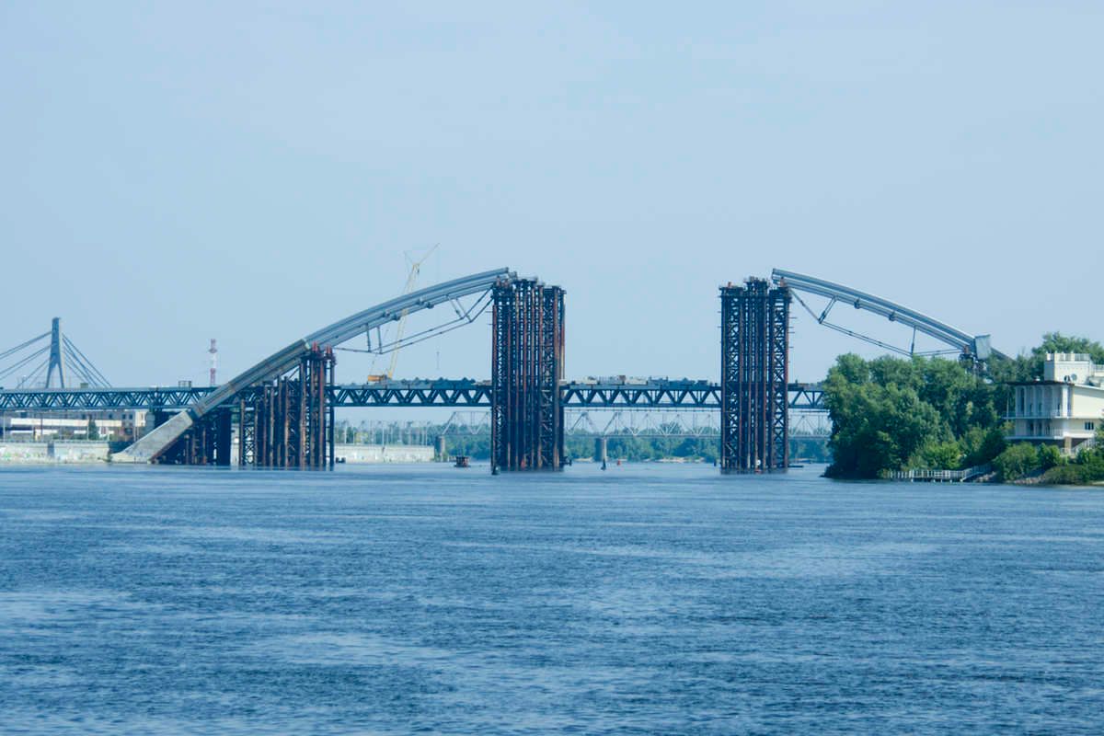
ongoing text problems
letters page, news in brief:
one article, multiple stories
text which grows:
timed paragraphs
never-finished text
grows because of online comments

Slide 38
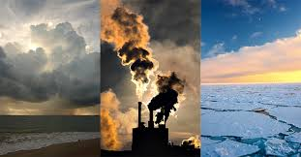
but are they really about climate change?
first decide what constitutes a climate change text….
is a description of a green energy project a climate change text?
a text on investments in oil?
Grundmann, Kreischer and Scott (forthcoming) struggled to agree on what counts as an austerity text

Slide 39
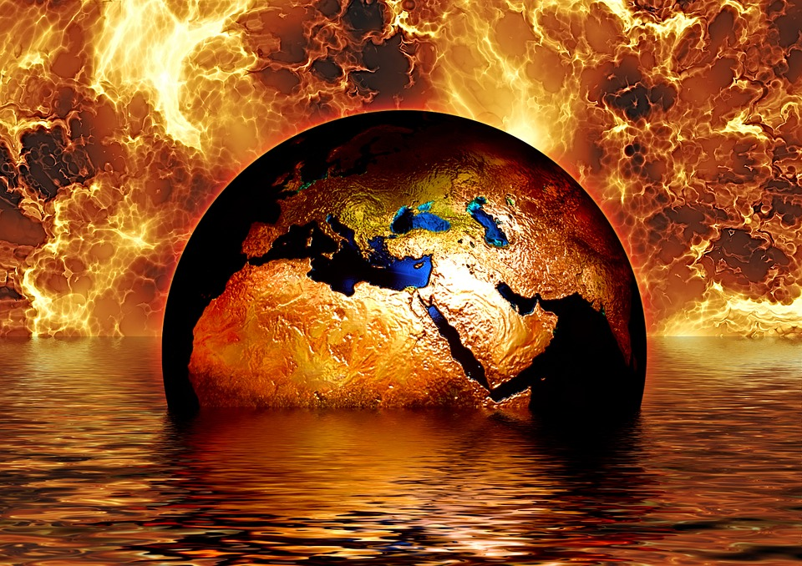
all we have is wording
assumption: they all contain at least one of the required phrases….

Slide 40
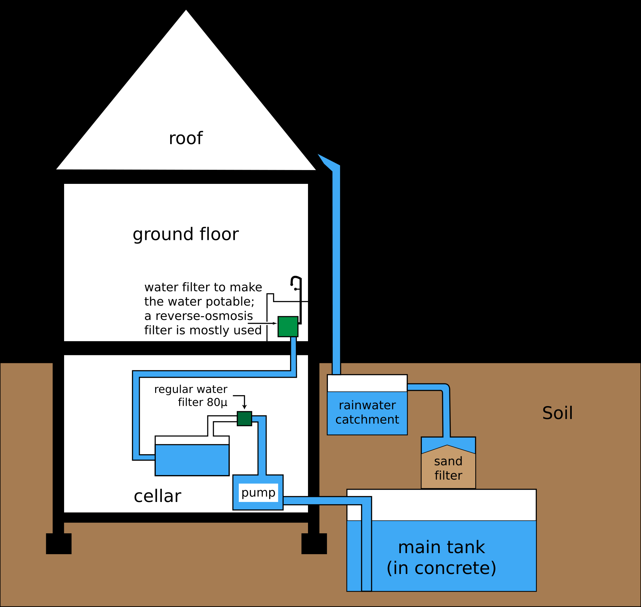
Filter needed

Slide 41
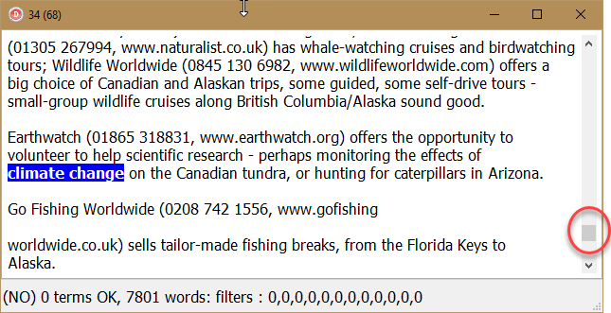
Sample of 100 articles randomly selected
500 to 2,000 words, mostly 600-1200.
three outliers
50 great things to do in America
1 climate change, at end of text,
below threshold

Slide 42
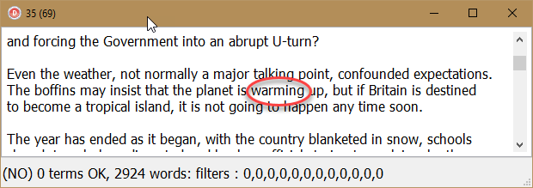
Outlier 2: 2010 The year in review

Slide 43
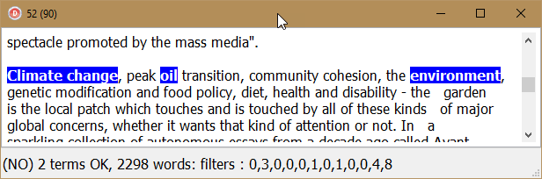
Outlier 3: Radical plots: the politics of gardening

Slide 44
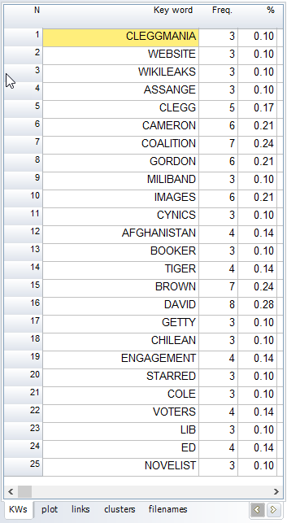
LexisNexis’ internal workings are a mystery
2010 The Year in Review contains “warming” but not any of the other terms. It was found in a search on greenhouse effect.
These are its key words

Slide 45
which sections of the broadsheet press?
and
blog, culture, global development, guide, health, politics, review, science, supplement, travel, voices

Slide 46
UK broadsheets do not use rigorously defined section names
leader
editorial
international
home
news
overseas
city
finance

Slide 47
Do the headlines help?
Comment & Analysis: It's a dirty job but someone's got to do it: It blights all our lives.
Saturday Review: Fiction: Hot slots: A story of love, climate change and the share index?
Blair: we must renew Trident
Reply: Face to faith: 'Liberal evangelicals' are now seen as a threat in the way Jesus once was, says Joanna Collicutt McGrath

Slide 48
Do the headlines help?
Is Decc's collaborative manifesto for Copenhagen web democracy in action?
The Guide: film choice: Your daily pick of the movies on TV this week, reviewed by Paul Howlett
Copenhagen climate failure blamed on 'Danish text'
World briefing A global crisis - and it's getting worse
It's time to talk honestly about fracking
Carbon emissions trading system 'seriously flawed'

Slide 49
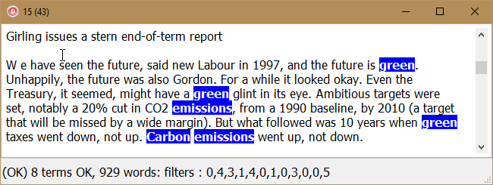
Some headlines are clear and useful
but some are cryptic
MUST TRY HARDER: the Labour government started well enough
-- about transport policy

Slide 50
Topic? it’s climate change +
field of knowledge
economics
climate change
history
politics
geography

Slide 51
climate change and nonce connection
gardening
climate change
outer ring
nonce relevance
biography
driving offences

Slide 52
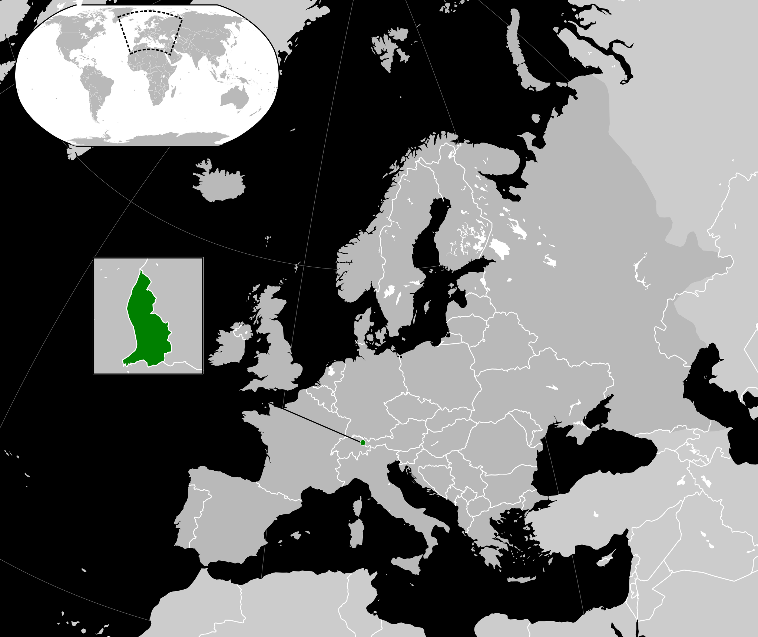
Either way, climate change might be…
…merely
incidental
apologies if you’re from Lichtenstein

Slide 53
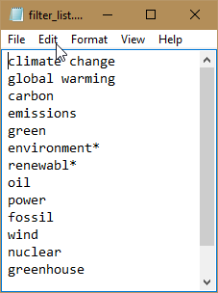
Automatic filter process
Key Words of existing (faulty) corpus as cleaned so far
Creation of filter list

Slide 54
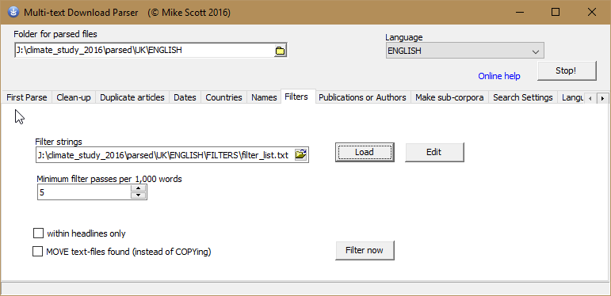
Download Program Filter section

Slide 55
Method
Each term sought in each text, measuring its frequency
Text is filtered out if
A) a minimum number of terms with a minimum frequency (taking text length into account)
and
B) the set of terms are spread evenly through the text (12 segments)

Slide 56
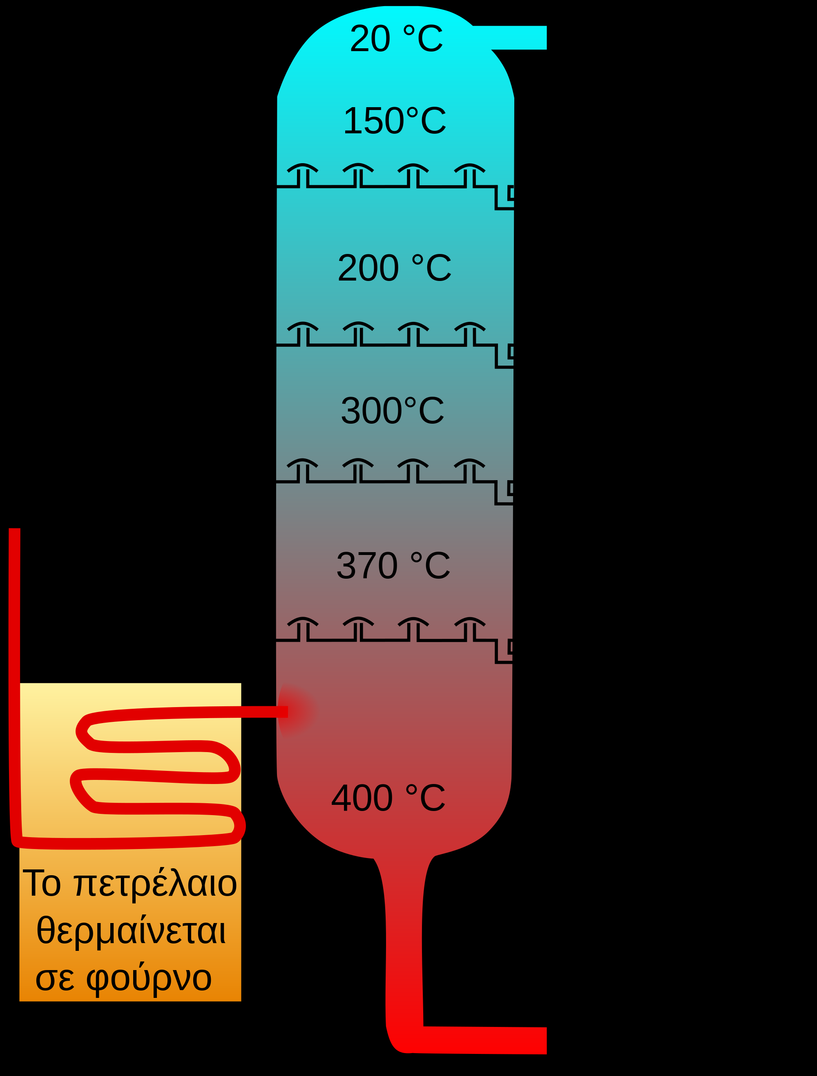
refining process
refining by
manually selecting some using key words of imperfect corpus
re-analysing and filtering
tweaking settings
corpus reduced to 30m words
(33,000 articles instead of 120,000)

Slide 57

Are they true climate change texts now?
there’s no guarantee!

Slide 58
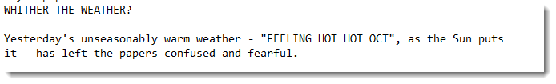
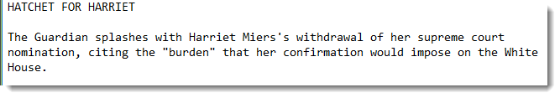
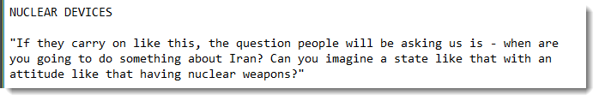
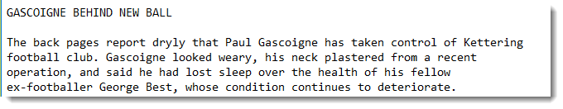

assorted stories in 1 text
etc.

Slide 59
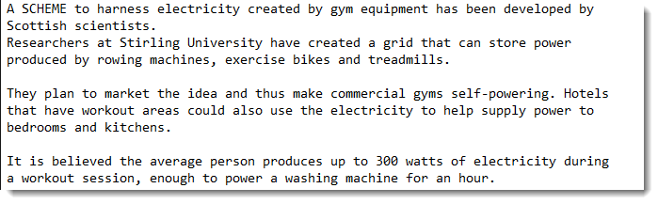

gym equipment
climate change
exercise

Slide 60
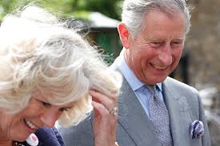
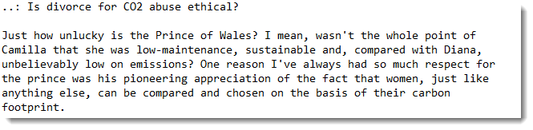
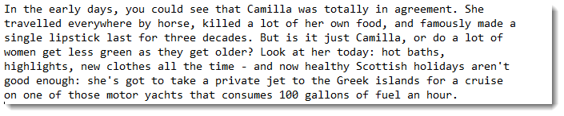

Prince Charles

Slide 61
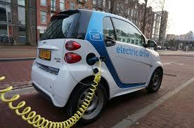
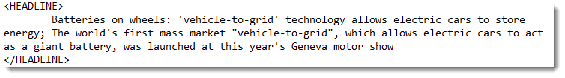

climate change
transport

Slide 62

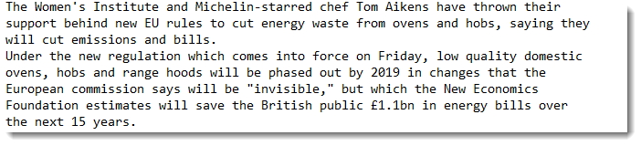

climate change
cooking

Slide 63
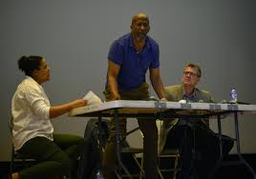
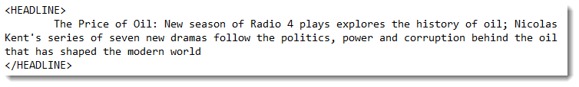

climate change
drama

Slide 64
clean-up process
iterative
recursive

Slide 65
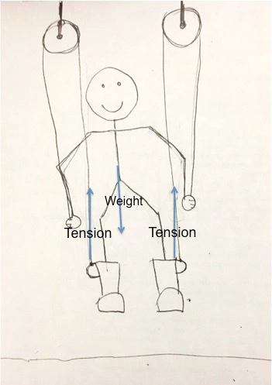
… finding true climate change texts means presupposing the outcome of this research
the bootstrap problem
Khayrallah, 2016

Slide 66
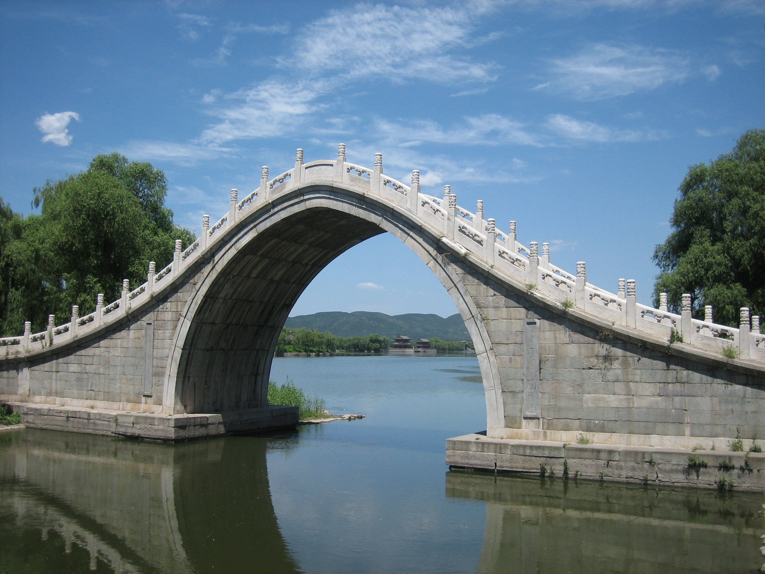
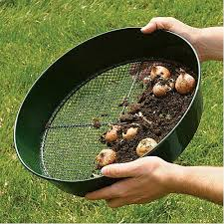
Conclusions
bootstrap problem in corpus creation
here attempting to refine by
manually selecting some using key words of imperfect corpus
re-analysing and filtering.
texts typically bridge fields of knowledge
unlikely to find a truly efficient non-iterative method
unlikely to get a ‘pure’ corpus which human informants agree 100% on

Slide 67
References
Bednarek, Monika & Helen Caple, 2017. The Discourse of News Values: How news organisations create newsworthiness. New York : Oxford University Press.
Dayrell, Carmen, 2015. Working Paper #1 The Brazilian Corpus on Urban Violence, http://cass.lancs.ac.uk/wp-content/uploads/2015/11/Working-paper-1-Corpus-Compilation.pdf
Gabrielatos, Costas, 2007. Selecting query terms to build a specialised corpus from a restricted-access database ICAME journal, 31: pp. 5-44
Grundmann, Reiner, Kim-Sue Kreischer & Mike Scott (forthcoming). The Discourse of Austerity in the British Press.
Grundmann, Reiner, Mike Scott, and Jin Wang,2013. Energy security in the news: North/South perspectives. Environmental Politics, 22 (2013/4): pp. 571-592.
Grundmann, Reiner and Mike Scott, Disputed climate science in the media: Do countries matter? Public Understanding of Science, 23(2014/2): pp. 220–235.
Khayrallah, Nadia, 2016. Blog. https://nadiainherownworld.wordpress.com/2016/01/21/so-you-think-you-can-pull-yourself-up-by-your-bootstraps-a-physics-problem/
Kitsch, Walter & Teun van Dijk, 1978. Toward a Model of Text Comprehension & Production. Psychological Review, Vol 85 No. 5.
Scott, Mike, 2002. ‘Picturing the key words of a very large corpus and their lexical upshots – or getting at the Guardian’s view of the world’ in B. Kettemann & G. Marko (eds.) Teaching and Learning by Doing Corpus Analysis, Amsterdam: Rodopi, pp. 43-50. cd-rom within the cover of the book. software still available here for download.
Scott, Mike, 2017. Download Parser. Stroud: Lexical Analysis Software, http://lexically.net/DownloadParser/

